Slide 1








NETFLIX-title dataset

Slide 2



Executive summary
  Netflix is one of the most popular media and video streaming platforms.
  They have over 8000 movies or tv shows available on their platform, as of mid-2021, they have over 200M Subscribers globally.
  This tabular dataset consists of listings of all the movies and tv shows available on Netflix, along with details such as - cast, directors, ratings, release year, duration, etc.

Slide 3



Details of the dataset
  Rows : 8807
  columns : 12
  non-null count : 6 columns have no null-values
  numerical columns : 1 numerical columns
  categorical columns : 11 categorical columns

Slide 4


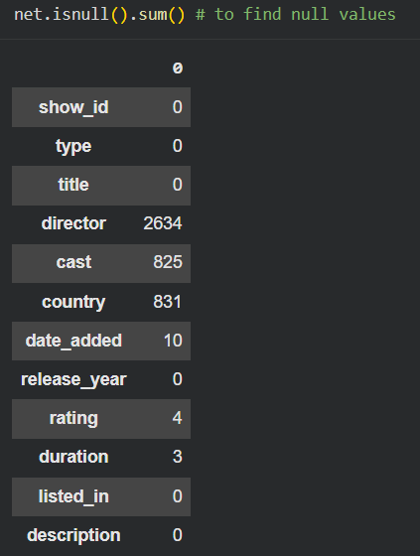


DATA CLEANING
  checkingnull values
  checking duplicate values
  standardize thedata

Slide 5

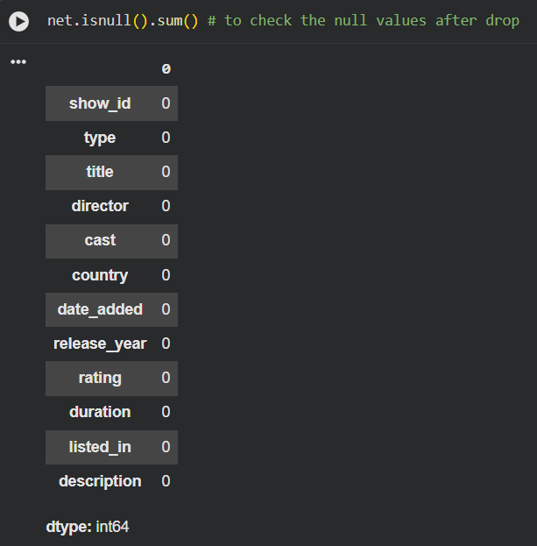
To drop null values & duplicate values
~to drop thenull values andduplicate values.

Slide 6

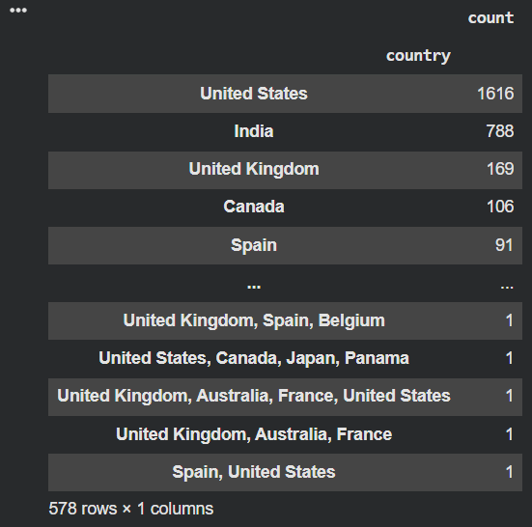
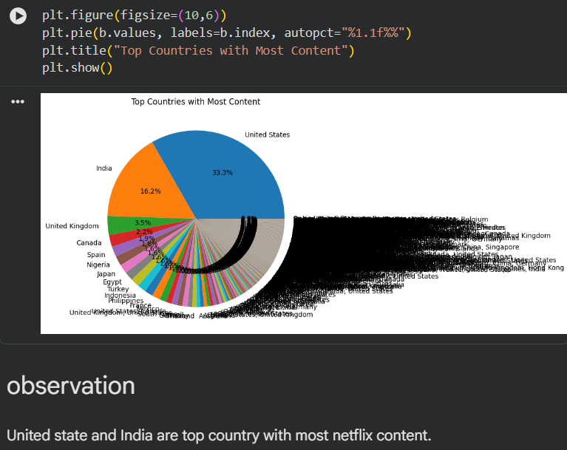
top countries with the most Netflix content?

Slide 7

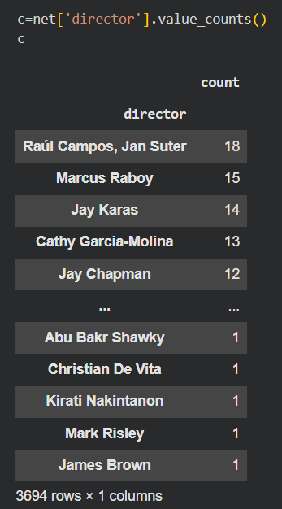
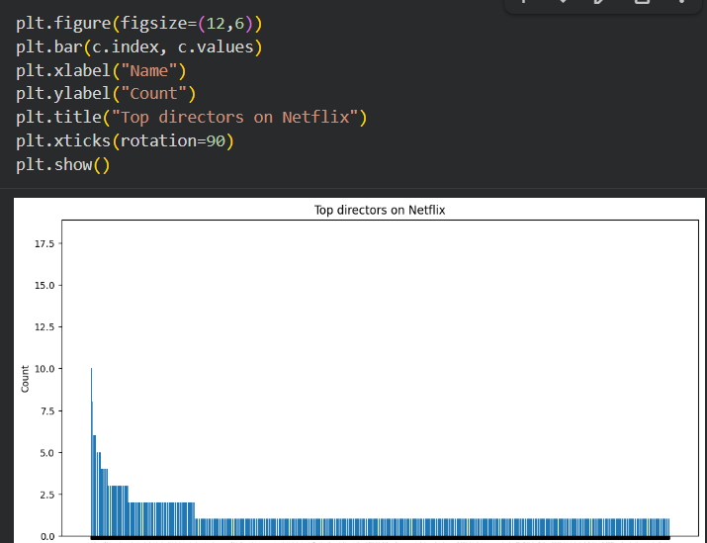

Which director has directed the most titles?

Slide 8
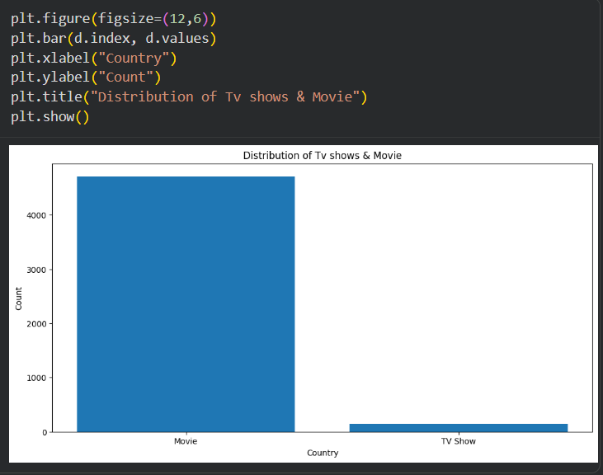
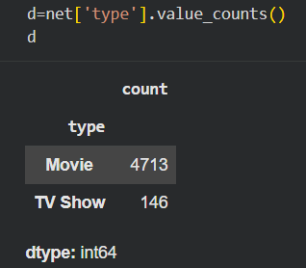
distribution of Movies vs TV Shows?

Slide 9


THANK YOU...!!!

